Slide 1

A Bite of data
DIANPING.COM RESTURANTS COMMENTS ANALYSIS
GAO, Yuan

Slide 2
RESEARCH TOPIC
Current study is an exploratory research based web comments and some relevent data. By adopting some data managing and text analytic techniques, the study try to find out some hidden information and patterns in web comments.

Slide 3
RESEARCH QUESTIONS
Do the emphases of user’s comments vary by the type of restaurant they evaluate?
Does the price of the restaurants correlate with the grades given by commenters and the sentiments in the comments?

Slide 4


DATA COLLCETION
20 Tianjin restaurants on dianping.com were selected for current study.
In total 29826 comments were extracted using Octoparse.

Slide 5





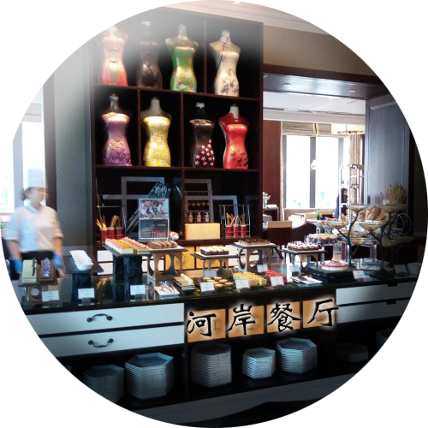
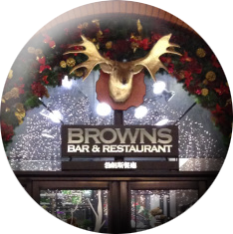




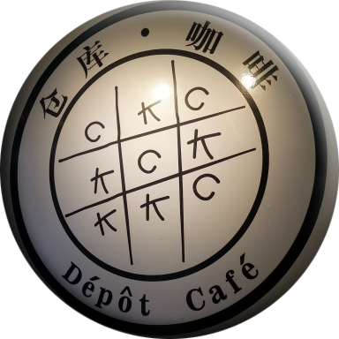





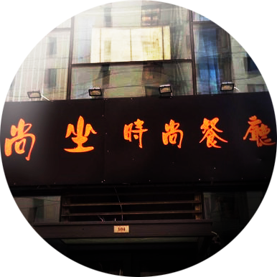

{
TIANJIN CUISINE
RESTAURANT
{
COFFEE SHOP
CAFETERIA
{
{
{
}
}
}
}
}
WESTERN
RESTAURANT
FAST FOOD
RESTAURANT

Slide 6
TAG ANALYSIS

Slide 7


WORD CLOUD
Tianjin Cuisine Restaurant
Western Restaurant

Slide 8



WORD CLOUD
Fast Food Restaurant
Cafeteria Restaurant
Coffee Shop

Slide 9
EMPHASIS ANALYSIS

Slide 10
EMPHASIS ANALYSIS

Slide 11
SENTIMENT ANALYSIS

Slide 12
Correlation Coefficient
| low-price sentim~t
-------------+--------------------------------
price | 1.0000
|
|
sentiment | -0.7038* 1.0000
|
| 0.0050
|
| high-price sentim~t
-------------+-------------------------------
price | 1.0000
|
|
sentiment | 0.4003 1.0000
|
| 0.5042
|

Slide 13
Thank You

